Slide 1



NUS Graduate School for Integrative Science and Engineering
How Personality Affects our Likes: Towards a Better Understanding of Actionable Images
ACM Multimedia 2017, October 26, Mountain View, CA, USA
Francesco Gelli*, Xiangnan He*, Tao Chen⁺, Tat-Seng Chua*
*National University of Singapore, ⁺Johns Hopkins University

Slide 2
OUTLINE
Research Goal
Personality
Dataset
Single Trait Study
Multiple Correlation Study
Action Prediction
Conclusions

Slide 3

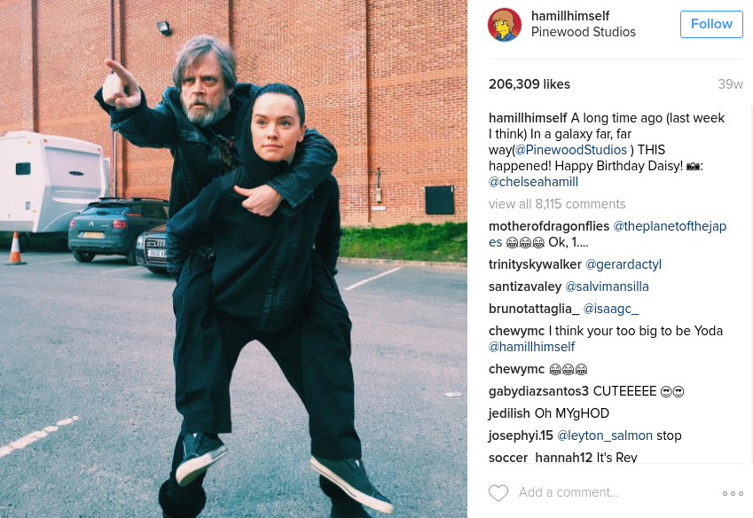
Research Goal
visit page
follow
Research Questions:
Does personality play a role in explaining users’ actions in social network sites?
Can we identify what visual stimuli influence users with specific personality?
Can personality help to predict users’ actions in advance?
like
comment
Notes:
Introduce what actionable images are. Maybe add a few text on the discovery of act images (hard, requires experts)

Slide 4
OUTLINE
Research Goal
Personality
Dataset
Single Trait Study
Multiple Correlation Study
Action Prediction
Conclusions

Slide 5


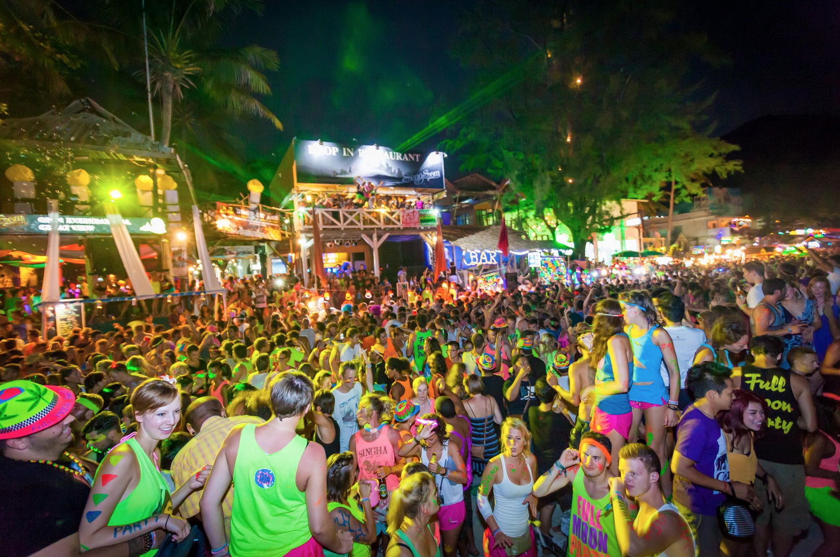
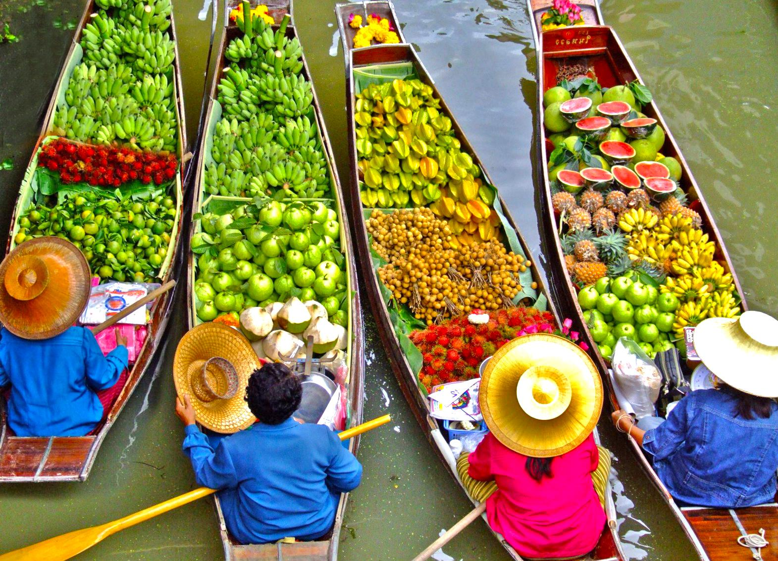
Why Personality? An Example
Mike
Age: 24
Gender: Male
Single
Very Talkative
Open to new things and experiences
Often friendly and in a good mood
Goes partying every week
Sometimes drinks too much
Sarah
Age: 35
Gender: Female
Married
Hard working and self disciplined
Creative and keen to arts
Sometimes gets easily stressed
Foodie and loves cooking
Subscribed to National Geographic
Demographic
Personality
Others

Slide 6
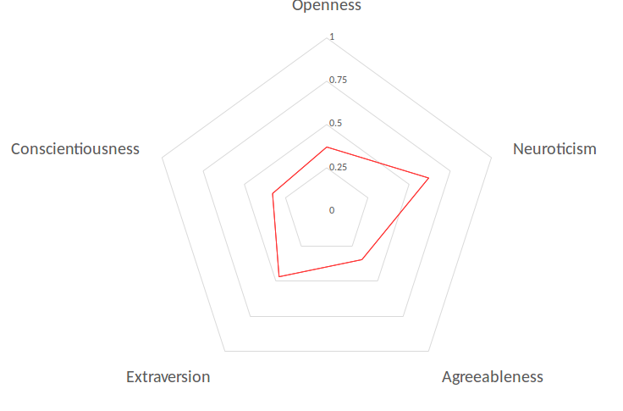
Personality: Big Five Traits
OCEAN Personality Traits
Openness: imagination and creativity
Conscientiousness: thoughtfulness, self-discipline
Extraversion: being outgoing, talkative
Agreeableness: cooperative, altruistic
Neuroticism: keen to negative feelings

Slide 7
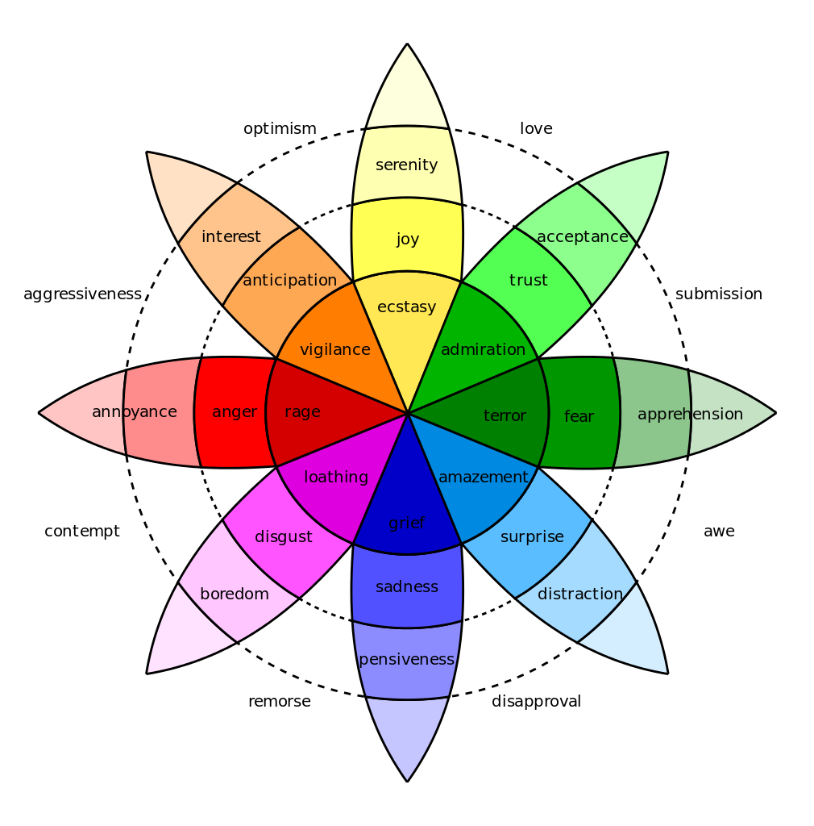

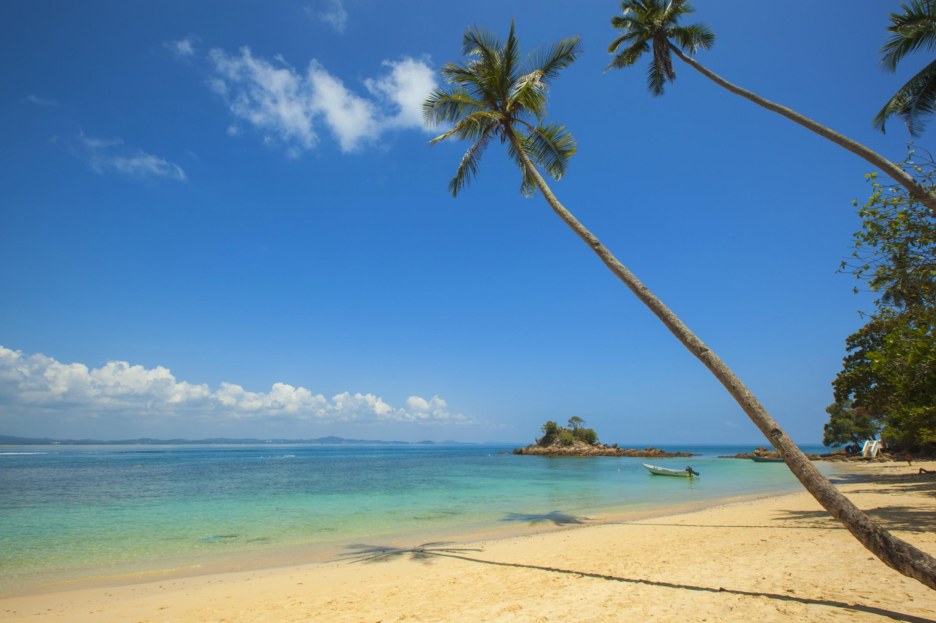

Personality and Emotions
Personality affects how people perceive emotions - Rusting, Psychological Bulletin 1998
Extraversion - Positive Affect
Neuroticism - Negative Affect
Correlation between Big Five traits and emotional processes, like reaction to daily incidents - Komulainen et al. PLOS ONE 2014
Neuroticism predicted higher negative and lower positive affect
Agreeableness was associated with higher positive and lower negative affect
Visual sentiment can be expressed with an ontology of 4342 concepts (Adjective-Noun Pairs) - Borth et al. ACM MM’13
We analyze the interplay between personality and concepts in social network images
personality
concepts

Slide 8
OUTLINE
Research Goal
Personality
Dataset
Single Trait Study
Multiple Correlation Study
Action Prediction
Conclusions

Slide 9


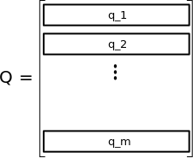
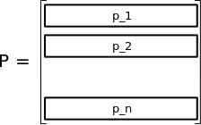
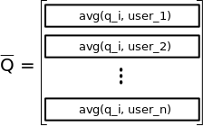
Dataset
Personality (Big Five)
1.Openness
2.Conscientiousness
3.Extraversion
4.Agreeableness
5.Neuroticism
Concepts
SereneBeach
LeargePalm
CalmSea
…
Retweet
Action
 | Users | Retweets | Tweets | Ratings
Training | 862 | 141,706 | 1,171,426 | 1,302,507
Testing |  | 7,218 | 68,006 | 68,101
p_i: Big Five traits for user i
q_i: distribution over concepts for image i
n: number of users
m: number of images
avg(q_i, user_j): average of all q_i retweeted by user j

Slide 10
OUTLINE
Research Goal
Personality
Dataset
Single Trait Study
Multiple Correlation Study
Action Prediction
Conclusions

Slide 11
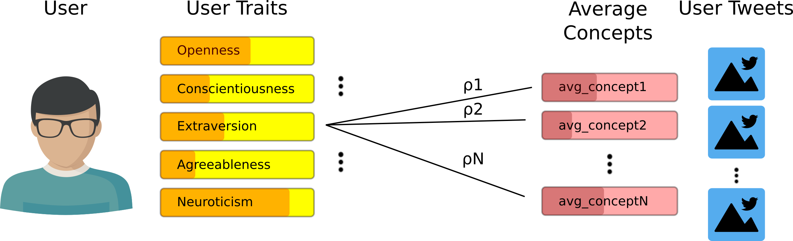
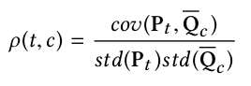
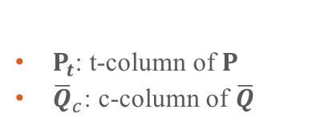
Single Trait Study
$Ρ_{t}$: t-column of $Ρ$
${\overline{Q}}_{c}$: c-column of $\overline{Q}$
Pearson Correlation Coefficient ⍴ ∊ [-1,1]
E.g:
⍴(Neuroticism, SadTimes) = 0.4
⍴(Extraversion, SadQuotes) = -0.3
⍴(Agreeableness, SillyDog) = 0.001

Slide 12
Single Trait Results
Openness |  | Conscientiousness |  | Extraversion |  | Agreeableness |  | Neuroticism
DryRiver | 0.27 | Environm.Issue | 0.42 | TightPants | 0.33 | Unanim.Winner | 0.35 | GoodMood | 0.48
HiddenPlace | 0.26 | FreshAir | 0.40 | HotSummer | 0.33 | OutdoorExterior | 0.30 | SweetKiss | 0.48
OldChurch | 0.25 | Hist.Landscape | 0.39 | FitWomen | 0.30 | FreshAir | 0.30 | SadGirl | 0.47
AncientChurch | 0.25 | YoungFarmers | 0.39 | BeautifulWife | 0.30 | PerfectLight | 0.30 | SweetLove | 0.46
OrthodoxChurch | 0.25 | RoyakBank | 0.39 | CrazyDays | 0.29 | LovelyDay | 0.30 | PersonalSpace | 0.44
BigBrothers | -0.23 | FatGirl | -0.37 | ScientificResearch | -0.33 | NormalLife | -0.34 | LargeEvent | -0.56
ActiveKids | -0.22 | SadGirl | -0.36 | ScientificStudy | -0.33 | PergnantWomen | -0.30 | CompetitiveSport | -0.48
SpecialKids | -0.20 | BadReaction | -0.35 | IndustrialWaste | -0.32 | HotYoga | -0.29 | Presid.Candidate | -0.46
FinalGame | -0.20 | SickGuy | -0.35 | SlowTravel | -0.31 | FunnyJokes | -0.28 | Presid.Campaign | -0.46
OutdoorTeam | -0.20 | SickGirl | -0.34 | NaturalSelection | -0.31 | SimpleMan | -0.27 | FairCity | -0.46

Slide 13
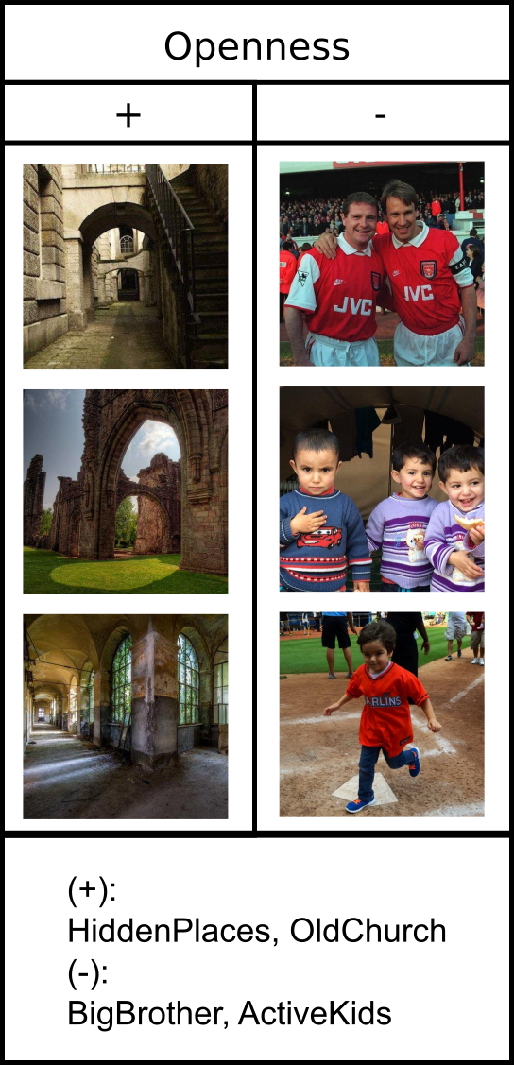
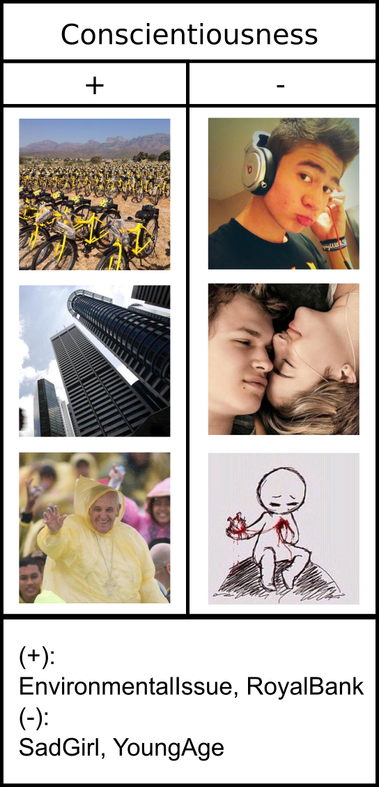
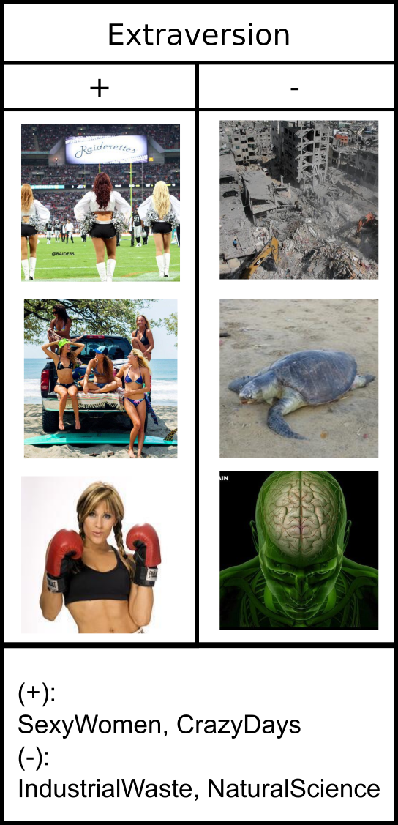
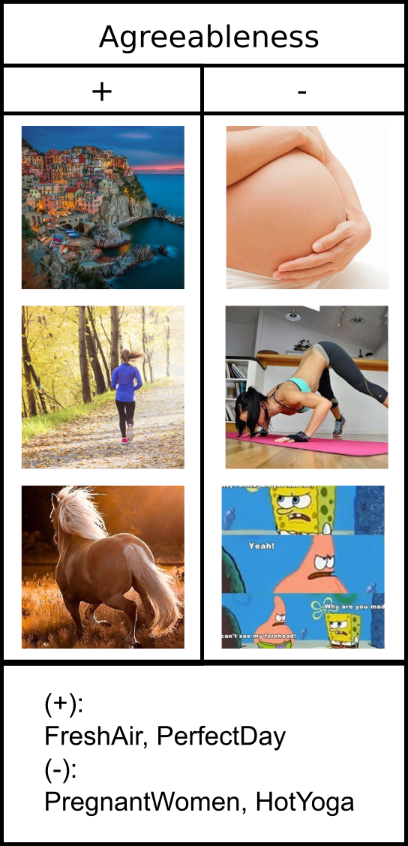
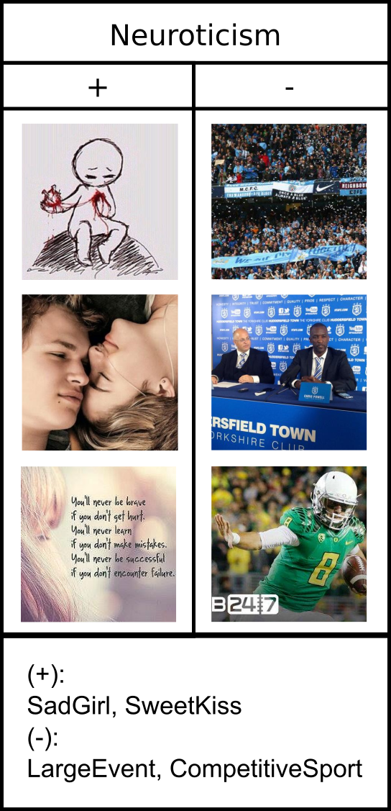
Single Trait Results (2)

Slide 14
OUTLINE
Research Goal
Personality
Dataset
Single Trait Study
Multiple Correlation Study
Action Prediction
Conclusions

Slide 15
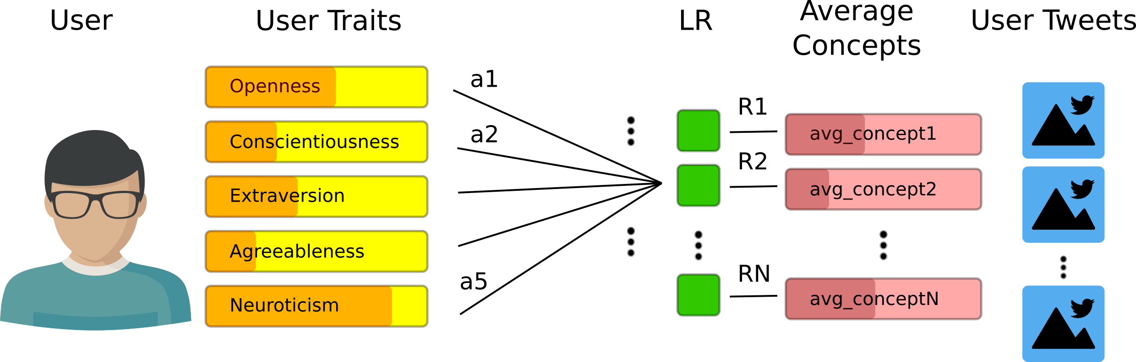
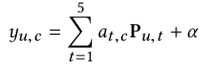
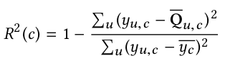
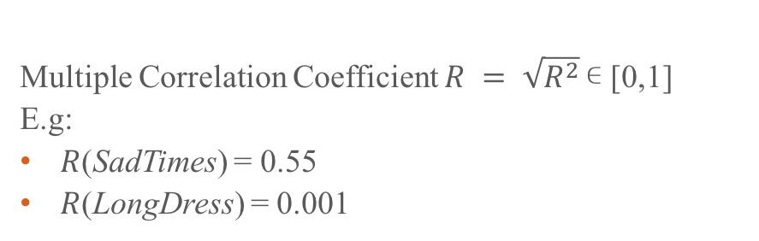
Multiple Correlation Study
Multiple Correlation Coefficient $R = \sqrt{R^{2}}$∊ [0,1]
E.g:
$R$(SadTimes) = 0.55
$R$(LongDress) = 0.001

Slide 16
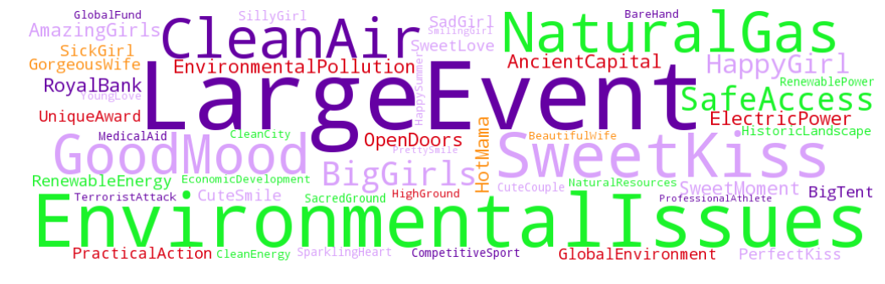
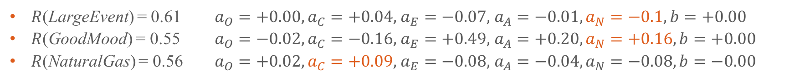
Multiple Correlation Results
$R$(LargeEvent) = 0.61 $a_{O}=+0.00,a_{C}=+0.04,$ $a_{E}=−0.07,$ $a_{A}=−0.01,a_{N}=−0.1, b=+0.00$
$R$(GoodMood) = 0.55 $a_{O}=−0.02,a_{C}=−0.16,$ $a_{E}=+0.49,$ $a_{A}=+0.20,a_{N}=+0.16, b=+0.00$
$R$(NaturalGas) = 0.56 $a_{O}=+0.02,a_{C}=+0.09,$ $a_{E}=−0.08,$ $a_{A}=−0.04,a_{N}=−0.08, b=−0.00$

Slide 17
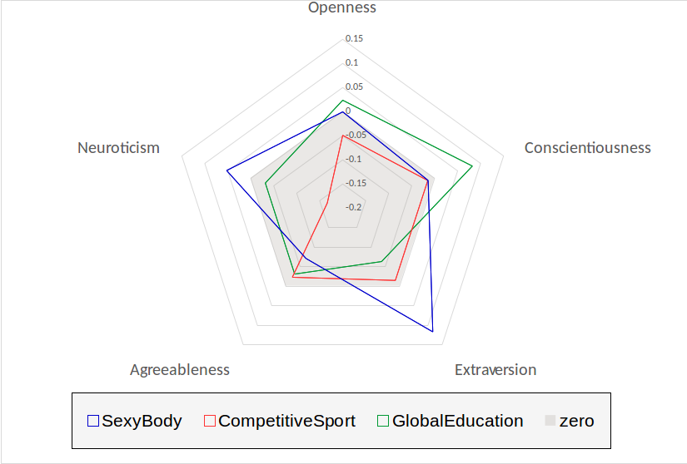
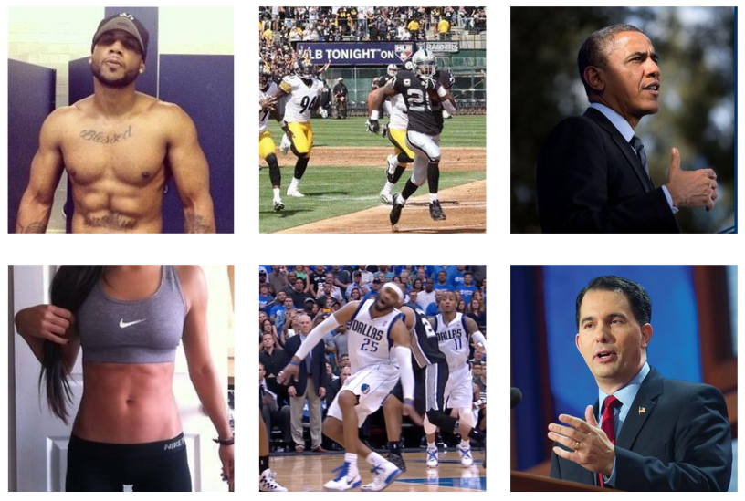
Multiple Correlation Results (2)
Regression Coefficients
SexyBody
CompetitiveSport
GlobalEducation

Slide 18
OUTLINE
Research Goal
Personality
Dataset
Single Trait Study
Multiple Correlation Study
Action Prediction
Conclusions

Slide 19
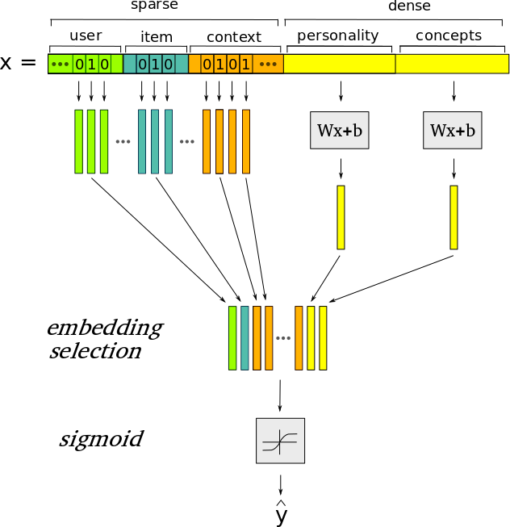
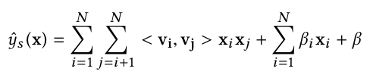
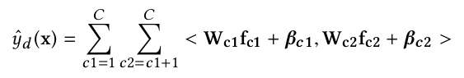
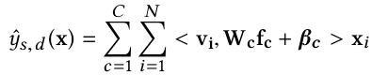
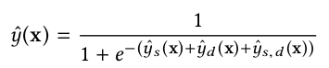
Action Prediction
Task: given user u and image i, estimate p(act(u,i))
Question: can the combination of personality and sentiment together help improving results?
Content-Aware Factorization Machines (CAFM) is proposed to handle both sparse and dense features
sparse input
dense input
sparse and dense input
final model

Slide 20
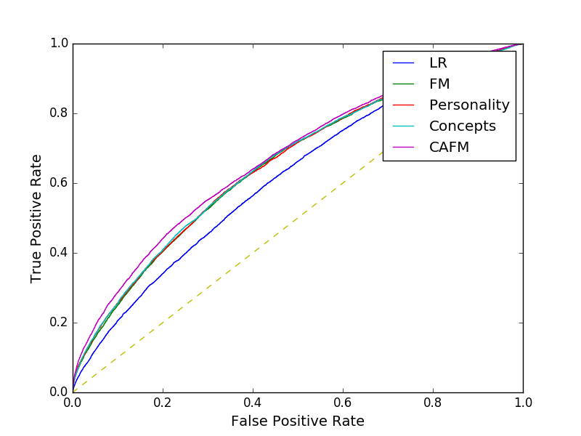
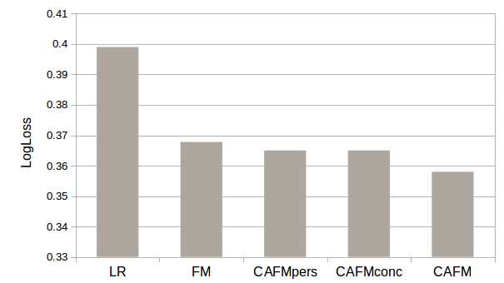
Action Prediction Results
ROC Curve
Baselines:
Linear Regression, context features (LR)
Factorization Machines, context features (FM)
CAFM, context and personality features (CAMFpers)
CAFM, context and concepts features (CAMFconc)
Area under ROC Curve
LR | FM | CAFM_{pers} | CAFM_{conc} | CAFM
0.618 | 0.656 | 0.658 | 0.658 | 0.673

Slide 21
OUTLINE
Research Goal
Personality
Dataset
Single Trait Study
Multiple Correlation Study
Action Prediction
Conclusions

Slide 22
Conclusions
A first step towards automatically discovering actionable images
Correlation is found between personality and affective visual concepts
We identified affective visual stimuli which are correlated with Big Five traits
Personality and visual concepts help predicting actions in advance
A possible future work is to discover actionable images for a specific message
We plan to integrate textual and social information.
THANK YOU
Code available at: https://github.com/GelliFrancesco/CAFM

